Slide 1



Word Frequency Counter
Project review
PRESENTED BY
MATHAN M 23ITR095
KARTHICK SARAVANAN R M 23ITR078
JAGADHEESH J 23ITR064
TEAM ID : DS_17
1

Slide 2
Objectives
Efficiently count and store the frequency of words in a text file.
Provide mechanisms to search, add, and remove words.
Implement different search algorithms to enable fast word lookup.
2

Slide 3
Problem Statement
The project aims to develop a program that reads a text file and efficiently counts the frequency of each word in the file. We'll focus on providing a user-friendly interface for analyzing text and presenting the results in a meaningful way.
Efficient Word Counting
User-Friendly Interface
The program should be able to analyze large text files efficiently, providing accurate word counts.
The program should be easy to use, allowing users to input text files and view the results clearly.
Sorted Output
The program should display the words in descending order of their frequency, providing valuable insights into the text.

Slide 4
Data Structures, Algorithms, and Concepts Used
We'll use data structures like hash tables and linked lists to store and manage word counts. Hash tables are efficient for searching and insertion, while linked lists handle collisions and allow for dynamic resizing.
1
Hash Tables
2
Linked Lists
Key-value pairs are stored, providing fast access to word counts. Collisions are handled by linked lists, ensuring efficient storage.
A chain of nodes storing words and their counts, allowing dynamic resizing and insertion. Efficient for managing collisions in hash tables.
3
Binary Search
4
Treenode Data Structure
Used to efficiently find a word's count in a sorted array, reducing search time. Useful for displaying results in descending order.
Hierarchical organization of words, allowing for efficient prefix searches and auto-completion features.
4

Slide 5
Modules and Functions
The program will be modularized into functions for readability and maintainability. This structure allows for clear separation of concerns and easier code reuse.
File Handling
Data Structure Management
Output Generation
Functions to read text files, split into words, and handle punctuation.
Functions to insert, search, and remove words from the hash table or linked list.
Functions to sort the word counts and display them in descending order.

Slide 6
Software and Tools
Java Development Kit (JDK): Used for coding and building the application with
support for AWT and data structures.
Java AWT (Abstract Window Toolkit): For creating the graphical user interface
(GUI) to for word frequency counter.
Java Data Structures (ArrayList, HashMap): Core elements for managing the inventory
and implementing efficient searches.
Integrated Development Environment (IDE):Used for writing, debugging, and
running Java code.
Version Control (Git): To manage and collaborate on the project codebase.

Slide 7

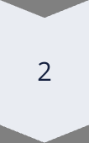
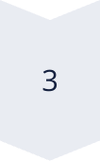
Implementation Details
The program will be implemented using a chosen programming language, incorporating the data structures, algorithms, and functions outlined in the previous sections. This will involve writing code for each module and ensuring its proper integration.
File Reading
Read the text file line by line, separating words based on spaces or punctuation.
Word Processing
Convert words to lowercase, remove punctuation, and update word counts in the hash table or linked list.
Output Generation
Sort word counts in descending order and display the results in a user-friendly format.

Slide 8
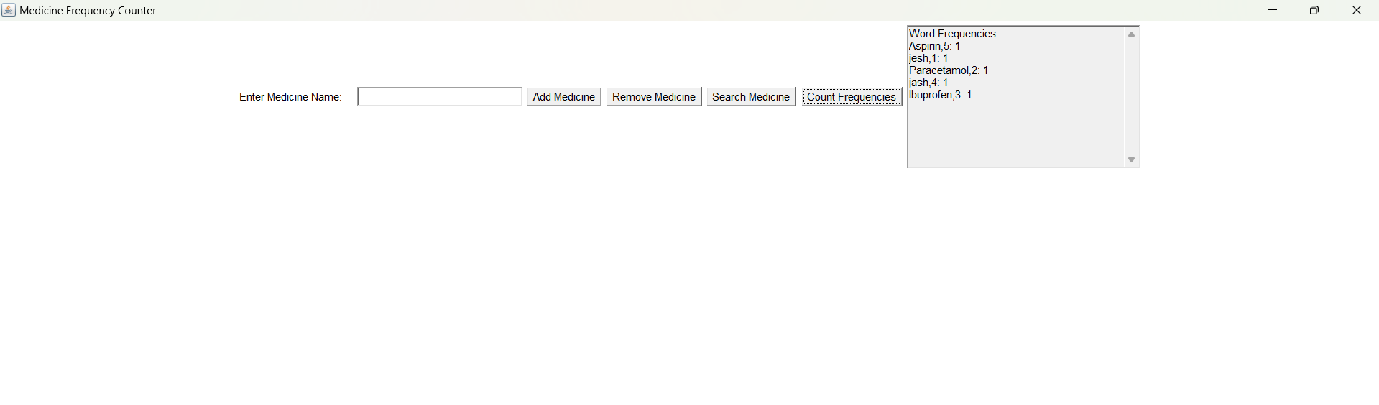
Output

Slide 9
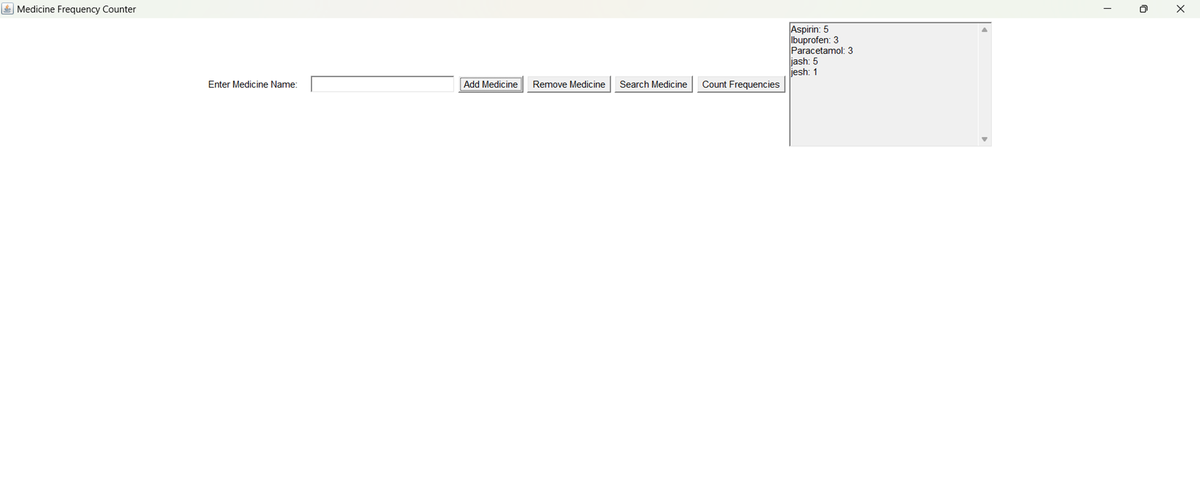

Slide 10
THANK YOU

